Slide 1
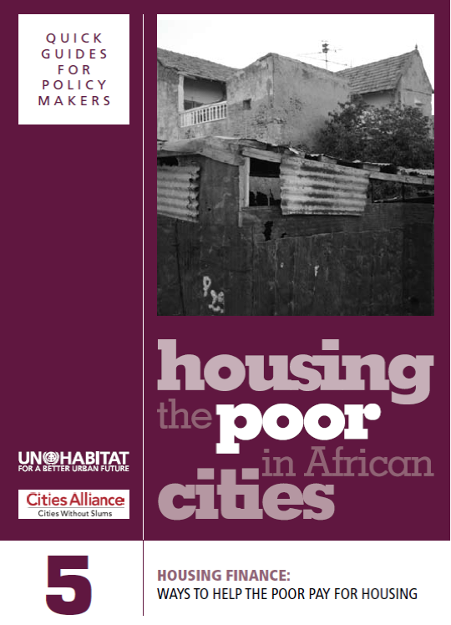

Slide 2
Learning Outcomes
Participants will be able to:
Explain why housing finance is important and how the housing finance system works
Discuss why poor have difficulty accessing housing finance and what options exist for them
Understand possible roles of the government
2

Slide 3
Structure of the Module
Importance of housing finance
Overview of how a housing finance system works
Mortgage loans and barriers to access
Financial access in Africa
How African households currently finance their housing
Reducing housing costs through design and policies
Possible roles of the government
3

Slide 4
Where do the Poor Live?
‘If a family does not have enough money to afford the cost of a formal dwelling available for sale or rent, they will have to find somewhere else to stay.’
‘The goal of a comprehensive housing finance system is to reduce the number of people who need to address their housing needs informally.’
>>Questions:
In your cities, what are their options?
What are the consequences – for them and for the local authorities?
What sort of housing finance scheme is needed for the urban poor?
4

Slide 5
An Ideal Scenario
‘To accommodate a wide range of housing needs and a growing population over time, a city needs to provide a steady supply of new housing and expand the existing housing stock by providing housing opportunities at scale for different segments of society.’
>>Questions:
To what extent is this happening in your own country?
What are the constraints?
5

Slide 6
Why is Housing Finance so Important?
Housing is a fundamental human need and right
Housing is expensive and it makes sense to borrow to pay for the house we are living in
Housing finance improves the performance of the housing asset
No government can meet all the housing needs of its population
Housing finance stimulates economic development
6

Slide 7
The Housing Finance System
Demand for and supply of formal housing units
Demand for and supply of formal housing finance to pay for these units
Activities of the government to help the process along such as subsidies, incentives and regulations
Informal processes of supply and demand for people who cannot access formal products and services
7

Slide 8
Four Conditions
Land must be available for formal purchase
Infrastructure (water, sanitation, energy and roads) needs to be in place
Lenders must offer development finance – construction loans at affordable rates
Buyers must be able to access loan finance to pay for the housing
8

Slide 9
The Housing Finance Dilemma
‘The problem with housing is not building it. We know how to build houses. It is not demand. There are plenty of people who want houses. The problem is allowing the people who want the houses the financing capacity to buy them.’
  Developer of the Lilayi Housing Development in Zambia
>>Question:
If people do not have the ready cash to buy a house, what are the possibilities of raising the finance?
9

Slide 10

A system for the Relatively Wealthy
The most common and, in principle, useful form of housing finance is the mortgage loan
Borrower buys house with mortgage loan
House as collateral against loan
Borrower
Financial institution
Loan payment from borrower to financial institution
Housing loan from financial institution to borrower
10

Slide 11
Conditions for Mortgage Loans
The bank has enough money
The borrower can afford the monthly repayment
There is a reasonable expectation that the borrower will keep his/her job for the term of the loan
The borrower will be able to get legal title over the house and it is worth the amount the borrower has requested
The repossession of the property is straightforward and supported by foreclosure laws that are enforced
>>Question:
Why can so few of these conditions be met in Africa?
11

Slide 12
Where do Lenders Get the Money for Housing Loans?
Lenders are defined by the way in which they get the money to lend:
Banks lend other people’s money (deposits) to borrowers
Contract savings institutions are deposit-taking institutions that specialize in housing loans
Mortgage banks do not take deposits and fund their loans by selling securities to investors
Securitization pools mortgages and sells securities on those pools to institutional investors
12

Slide 13
1. Banks
Interest Payments
Savings
Loans
SAVERS
BANK
BORROWERS
Interest Payments
13

Slide 14
Ingredients of a Loan
Capital amount: Amount borrower can borrow from lender
Interest: Fee paid for the service of borrowing money
Collateral: What is offered to the lender to hold in security in the event the borrower is unable to repay the loan
Deposit: Initial amount the borrower pays towards the cost of the loan
Risk: Possibility that the expected returns of an investment will be less than forecast
14

Slide 15
2. Contract Savings Institutions
Building societies were originally savings clubs but over time formalized – but few remain in Africa
Current contract savings institution model is popular in some European countries, and parts of Africa and Latin America
Savers enter into a contractual agreement with the institution to save for a specified period or up to a specified amount – usually at a below-market, fixed rate of interest
Once contractual obligations are fulfilled, borrower is enabled to take out a below-market, fixed-interest rate loan
In many cases governments support these institutions by offering savings bonuses and favourable tax treatment
>>Question:
What are the challenges with such schemes?
15

Slide 16
3. Mortgage Banks
Borrower
Savings
Pension or Insurance
Institutional
Investors
Institutional
Investors
Investment Capital
Securities
16

Slide 17
4. Securitization
Mortgage bank pools mortgages and sells the pool to a special purpose vehicle (SPV)
SPV invites investors to buy securities in the pool – the secondary mortgages market.
These securities are called ‘mortgage-backed securities’ and investors are promised a portion of the collections from the loan package
The scheme lessens the risks for the bank, improves its liquidity and means it can give out loans more freely.
>>Question:
What was the problem with the securitization industry that threatened the global economy in the years 2007-2010?
17

Slide 18
Assessing Affordability
Using a percentage of a monthly income – usually estimating that households can only afford between 20 per cent and 30 per cent of their income in paying back a loan
Subtracting actual expenditure from monthly income
Testing affordability by means of a probationary savings period prior to making a loan
Ability to make a downpayment of the housing loan
18

Slide 19
Financial Access in Africa
19

Slide 20
Why Fewer than 15 Per Cent of Africans Can Access Mortgages
Need stable, formal employment
Few earn enough to afford the loan
Few properties are legally able to perform as security
Few borrowers have bank accounts
There are few mortgage providers in Africa
>>Question:
What other options for finance are there?
20

Slide 21
Interest Rates
The fee charged for lending money
Calculated as a percentage of capital amount payable on a monthly basis
Sometimes governments try to force housing finance institution to keep interest rates low to benefit the poor
The consequence can be that banks are unable to cover their costs
Rates often change during the course of loan repayments
>>Question:
For borrowers, what are the consequences of rises and falls in interest rates?
21

Slide 22
What Systems Exist for the Poor?
Non-mortgage loans – usually smaller than mortgages, payable over shorter period
  Pension-backed loans
  Housing micro-loans
Informal finance – an incremental financing approach, often a matter of saving materials rather than cash, until enough is available for construction
22

Slide 23
Understanding Pension-Backed Loans for Housing
PENSION FUND
Pension
Administrator
FINANCIAL INSTITUTION
Housing Loan
Loan Payments
Savings into the
Pension fund
PENSION FUND MEMBER
23

Slide 24
Housing Micro-loans
For relatively small amounts
Repayment periods relatively short
Loan pricing covers long-run costs of the operation
Generally unsecured
Finance habitat needs incrementally
Often grow from conventional micro-finance lending
24

Slide 25
Incremental Housing Process
A step-by-step approach to financing gradual improvements to housing
‘If all other planning and environmental conditions are met, and no conflict exists about land rights, governments can provide basic infrastructure and ensure security of tenure, and then slowly, step-by-step, people will begin to build their homes and improve their living environments independently.’
>>Questions:
Do you agree with this optimistic view?
To what extent is it happening in your country?
25

Slide 26
Understanding the Housing Asset
Family safety net, citizenship building, neighbourhood consolidation
Social Asset
Inheritance, household wealth and equity potential, access to finance
HOUSING ASSET
Sustainable livelihoods through income generation: home based enterprises and backyard rentals
Financial Asset
Economic Asset
26

Slide 27
Supporting the Housing Processes of the Poor
Providing land with secure tenure and basic services
Advising on housing design and construction
Making people aware of their financial and legal rights and obligations
Advising on possible improvements
27

Slide 28
What Role Should Governments Play?
‘Most countries have moved, or are slowly moving, away from an emphasis on government provision of housing to government facilitation for housing developed and financed by non-state actors such as the private sector, community groups and cooperatives.’
>>Questions:
For the poor, is this a desirable shift in policy?
To what extent is it happening in your country?
To what effect?
28

Slide 29
What Role Should Governments Play?
Stimulate and create institutional, legal and policy environments enabling non-State actors to play an active role in housing finance and supply
Promote supply of a variety of affordable housing solutions
Enable the development of different housing outcomes
Establish a policy dialogue with lenders, builders and developers
Promote savings for housing as a national level priority
>>Questions:
To what extent are these things happening in your country?
What are the constraints?
29

Slide 30
Making a Market Map
Using the Access Frontier Tool
Current market: those who have a housing loan
Market redistribution zone: those who are too poor to access a housing loan
Market enablement zone: those who are within reach of a market but do not have a housing loan
Market development zone: those who cannot access a housing loan, given their location or income profile and the products current pricing structure but who are likely to access the market in the near-term, given product/market innovation
>>Question:
What is the use of this analysis for policy makers?
30

Slide 31
Six Ways to Reduce Housing Costs
Design
Mass-producing housing units
Internal cost subsidies
Self-building by people
More practical, more realistic and more flexible building standards
Standardized building components and appropriate technologies
31

Slide 32
Cost Reduction Through Design
Designing tight housing layouts
Designing housing units of a smaller size
Using community and household labour
Using alternative, recycled or cost-saving materials
Buying materials and houses collectively
32

Slide 33
Mass-producing Housing Units on a Large Scale
High- or mid-rise blocks of apartments
Reproducing a standard unit for detached or semi-detached houses
Depends on participation of city councils or municipalities:
  Setting up fast track approval processes
  Offering support to developers in meeting regulations
33

Slide 34
Internal Cost Subsidies
Cross-subsidizing low-income housing through profits from sale of market-rate housing units on the same development
This promotes integration and socio-economic diversity in new settlements
34

Slide 35
Self-building
‘Supporting people to build their own housing is one of the best ways of reducing costs, making housing affordable to low-income households and creating a vibrant housing stock in the city.’
35

Slide 36
More Practical, Realistic and Flexible Building Standards
‘Many argue that…housing and building standards are too high; roads are too wide, plots are too big, setbacks eat up too much space, engineering standards are too conservative and service levels are too high.’
36

Slide 37
Standardized Building Components
Promote use and production of standardized components which can be bought off the shelf by householders
Can be made on smaller scale by local entrepreneurs
37

Slide 38
Five Ways Government Can Support Downmarket Lending
Get the macroeconomic environment right
Get the housing supply picture right
Encourage existing lenders to extend mortgage loans downwards
Promote alternative forms of housing finance
Collect, organize and distribute data about housing needs and affordability parameters
>>Question:
To what extent are these happening?
38

Slide 39
Conclusions
Housing finance is very important
Few people in Africa can access mortgages but some other forms of finance also exist such as housing micro-loans
Government has a role to play in enabling conditions for housing finance
Housing costs can also be reduced through design and policies
39

